Slide 1
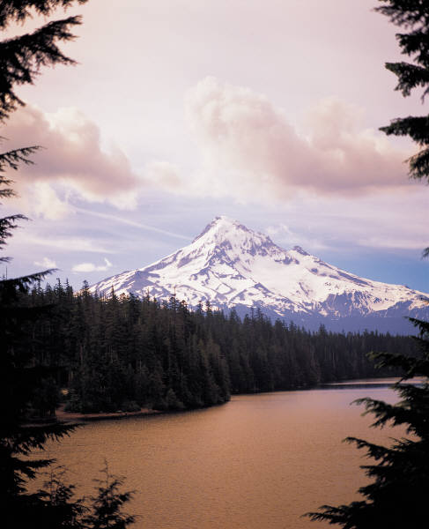
Volcanoes

Slide 2
Volcano Structure
Magma Chamber-a location where magma collects inside the Earth.
Conduit-a passage where magma can move out of the magma chamber
Vent-a place where magma exits the volcano
Sill-sideways movement of magma. Usually found between rock layers
Dike-upward movement of magma away from the conduit

Slide 3
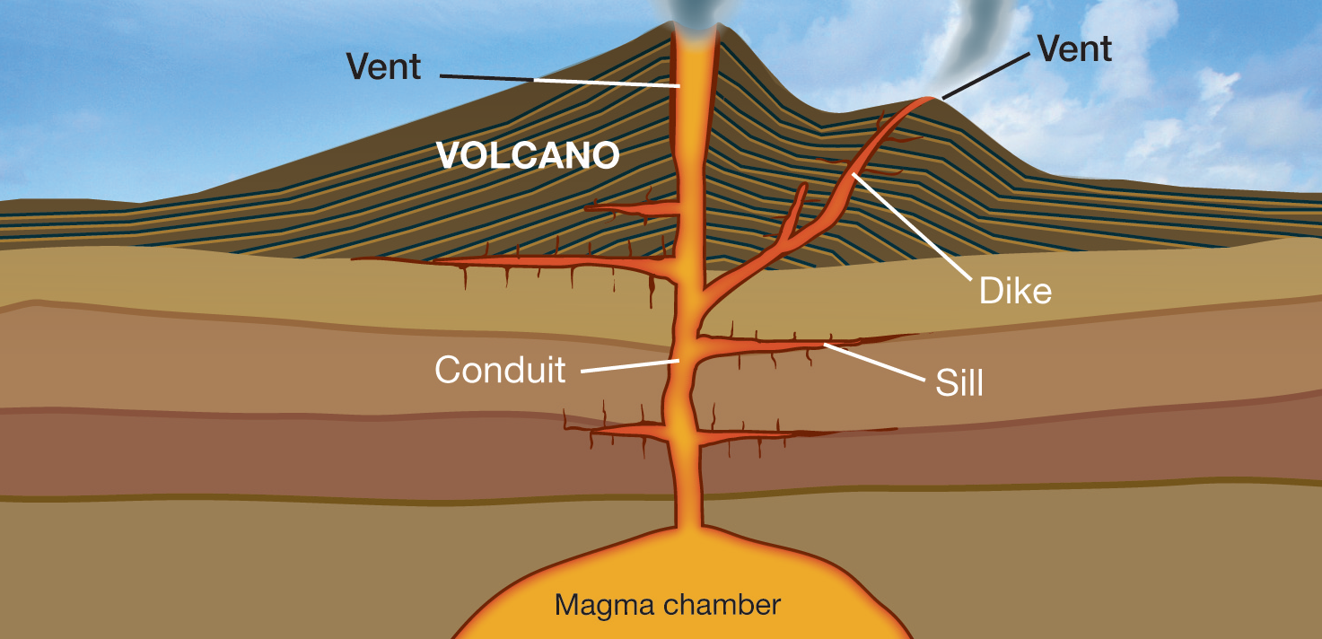

Slide 4
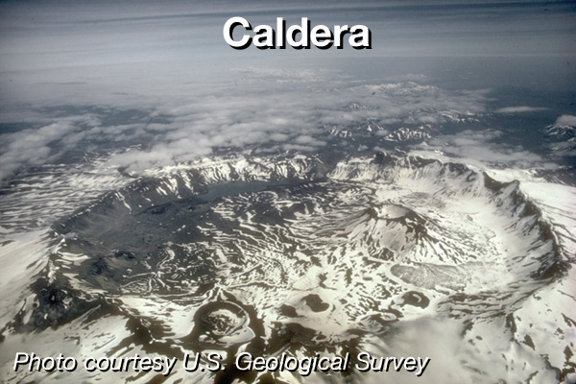
Volcanic Features
Caldera-a bowl-shaped depression formed by the collapse of a volcano after an eruption
Resurgent Dome-a mound in the vent or caldera of an erupted volcano

Slide 5
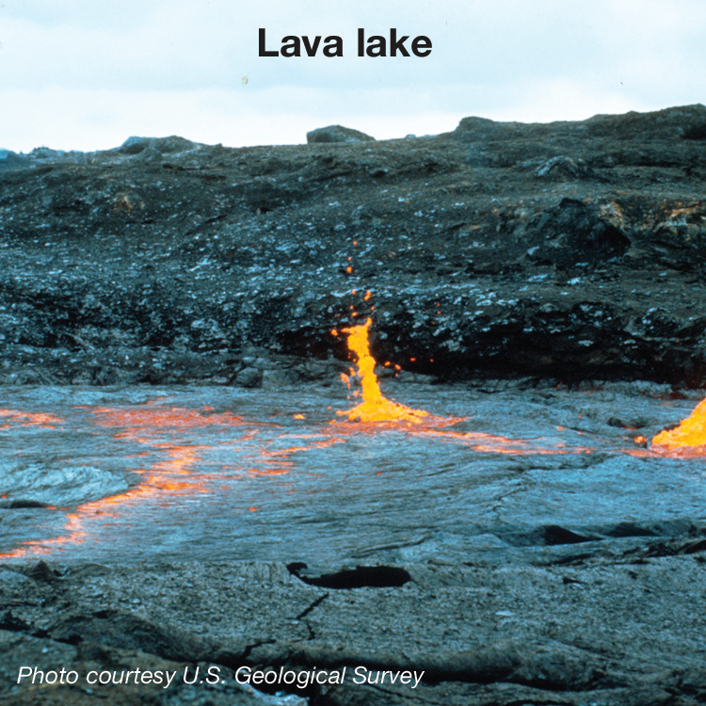
Lava Lake-a pool of lave that has formed in a caldera

Slide 6
Volcano Life Cycle
Active volcano -a volcano that is erupting or that has erupted recently
Dormant volcano-a volcano that is not erupting now but that may erupt in the future
Extinct volcano-a volcano that no longer erupts and is in the process of eroding
Volcanic neck-solid remains of magma that filled the conduit.

Slide 7
Magma
Magma is molten rock
Temperature, pressure, and water content affect the melting temperature of rock
Increase temperature-increase melting point
Increase pressure-increase melting point
Increase water content-decrease melting point due to the change in the rocks composition

Slide 8
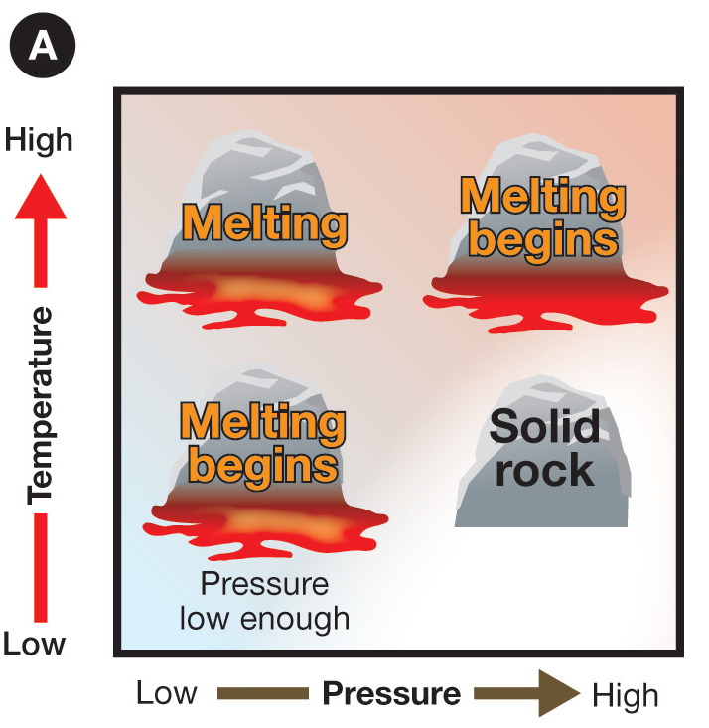
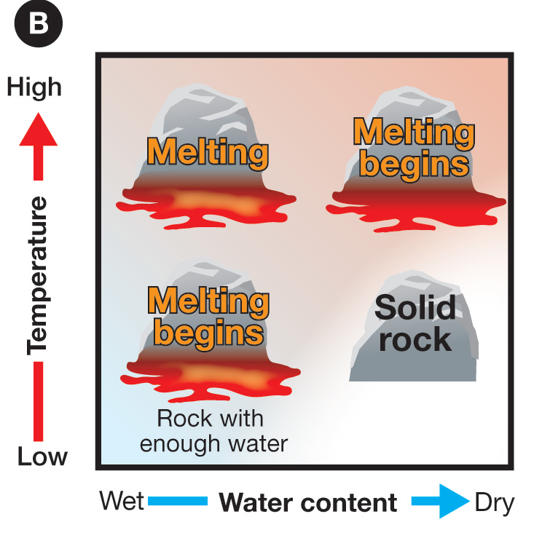

Slide 9
Magma Types
Silica content
High-sticky thick lava (granite)
Low-runny (basalt)
Gas content
High-runny, bubbly lava
Low-thick sticky lava

Slide 10
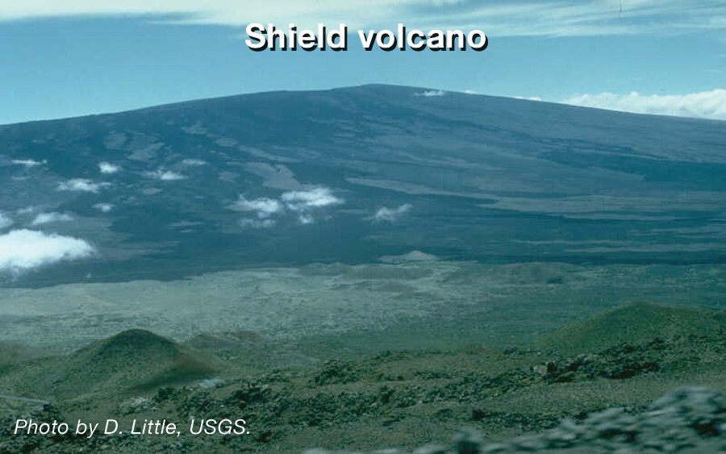
Low Silica Volcanoes
Shield-flat, wide volcano

Slide 11
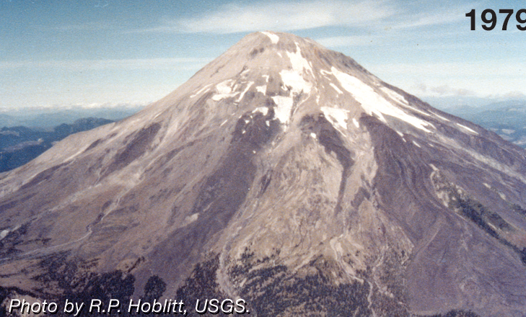
High Silica Volcanoes
Composite/stratoform volcanoes
Mt. Saint Helens

Slide 12
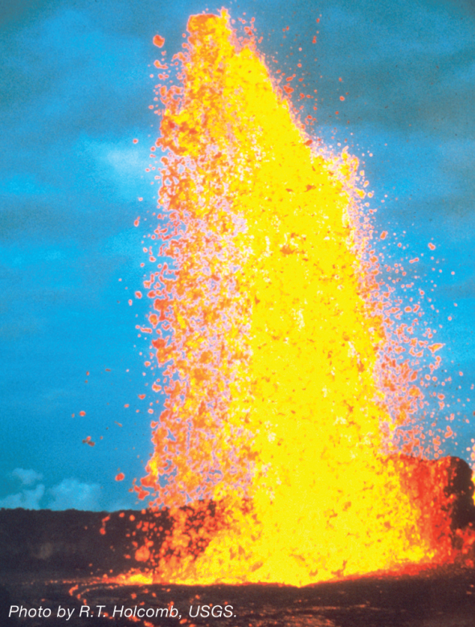
High Gas Volcanoes
Cinder Cones and Fire Fountains low silica
Cinder cones are structurally weak due to loose rock and debris low silica
Explosive eruptions high silica
Pumice and ash

Slide 13
Low Gas Volcanoes
Quiet eruptions
High silica-thick sticky magma
Low silica-runny magma like syrup

Slide 14
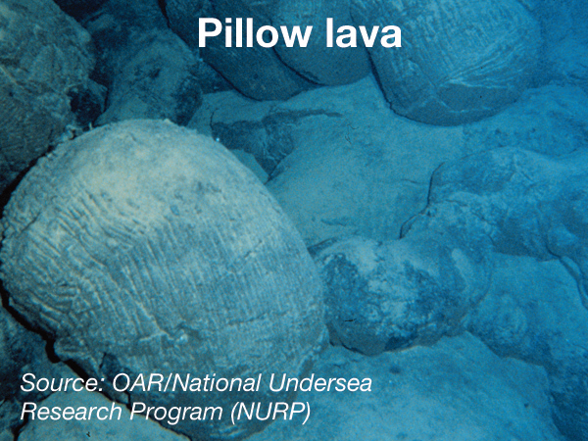
Divergent Plate Volcanoes
Mid-ocean ridge
Basaltic lava-low silica
Pillow lava

Slide 15
Oceanic Convergent Plate Volcanoes
Volcanic island arcs
Aleutien Islands, Japan
Ring of Fire
Silica rich

Slide 16
Continental Convergent Volcanoes
Silica rich
Water lowers the bp
Less dense
Granite and andesite
Andes mountains
Granitic Domes-Yosemite National Park

Slide 18
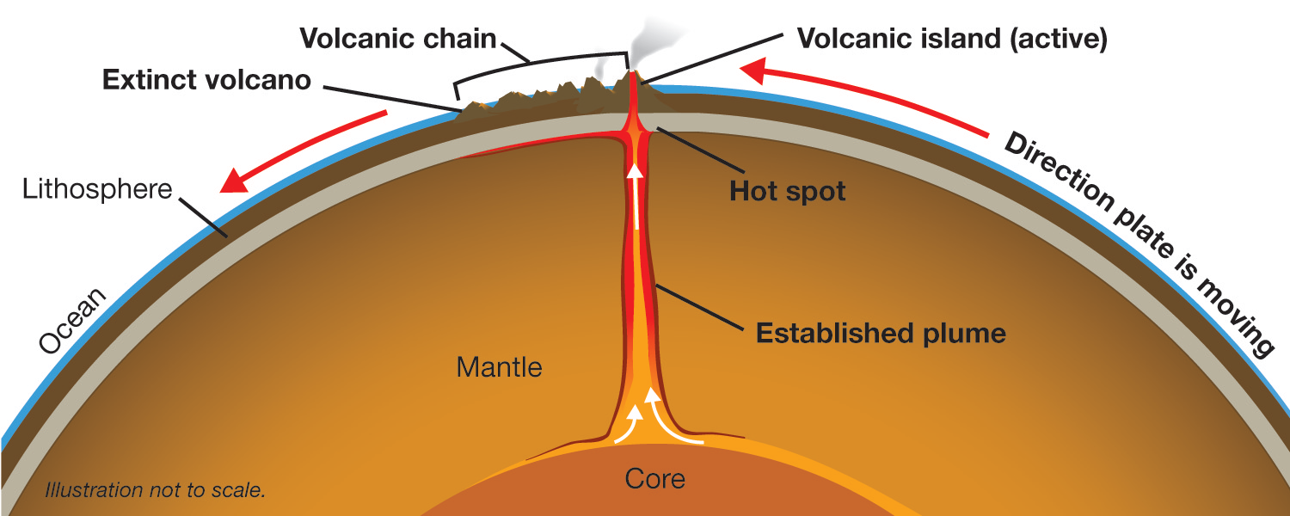
Volcanic Island Chains
Mantle Plume
Hot spot
Chain follows the plate movement

