Slide 1
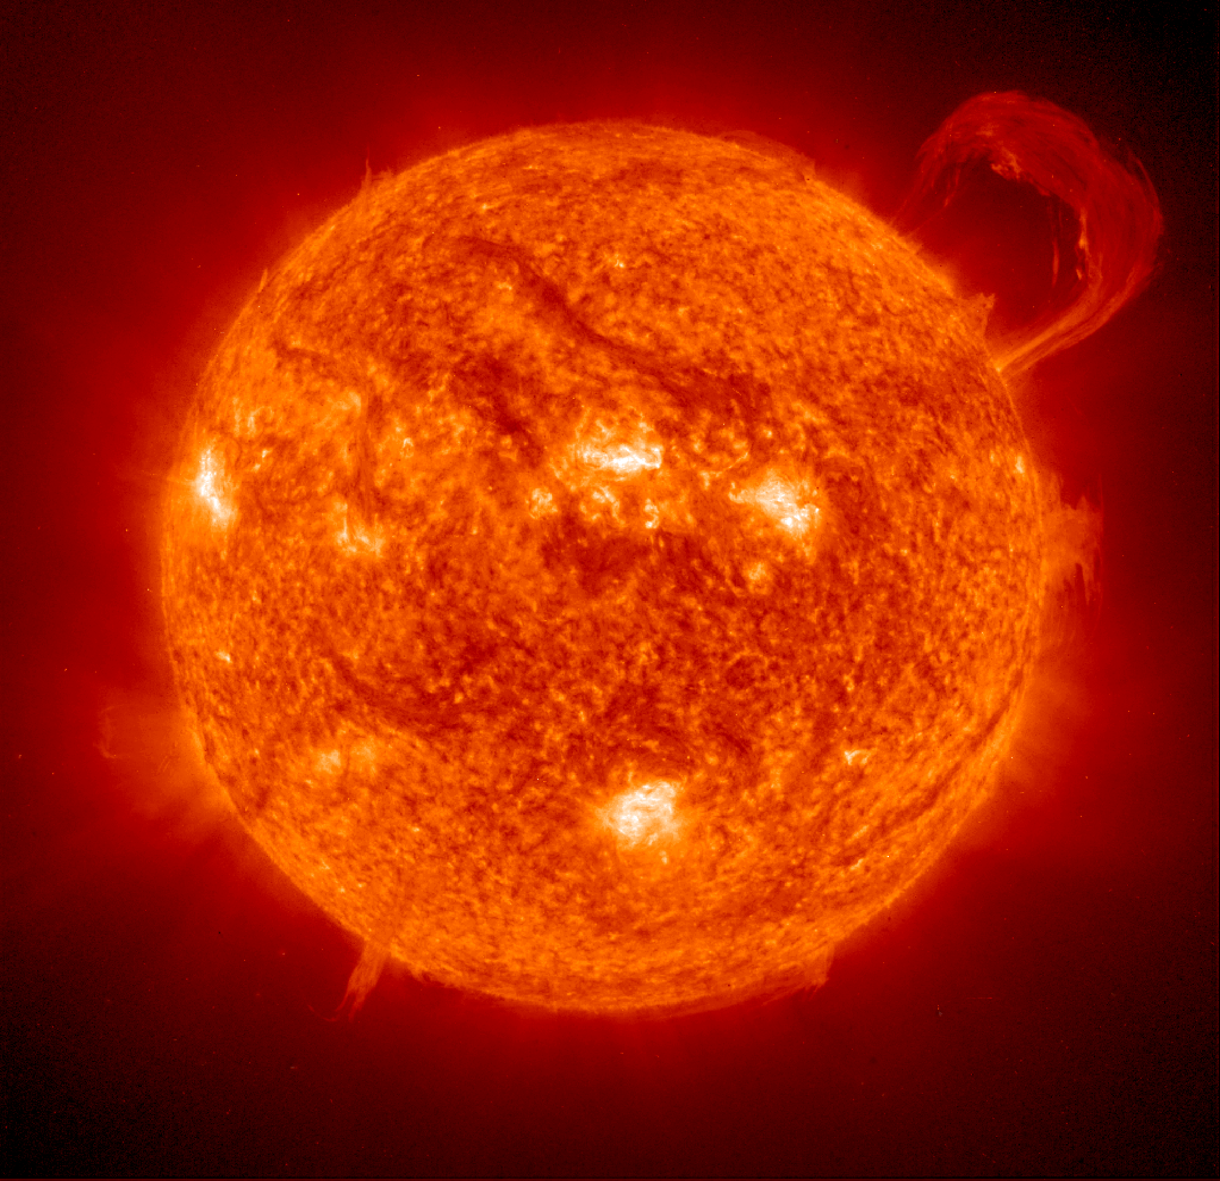
The Sun
Notes:
Revised for Harris County Dept of Education Workshop, Feb. 3., 2009, by
Christine Shupla, shupla@lpi.usra.edu
Photo from http://sohowww.nascom.nasa.gov/bestofsoho/bestofsoho.html

Slide 2
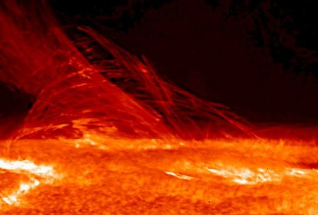
The Sun
Is a medium sized star
Made of gases (70% hydrogen and 28% helium)
It is our primary source of energy (heat & light)
One Astronomical Unit is the distance from the sun to Earth (93,000,000 miles. Abbreviated AU)
Image at http://science.nasa.gov/headlines/y2007/images/chromosphere/LimbFlareJan12_strip2.jpg
Notes:
The Nine Planets website has all of this excellent information: http://seds.lpl.arizona.edu/nineplanets/nineplanets/sol.html
The Sun contains 99.8% of all of the mass in our Solar System.
It is a yellow, medium-temperature star– 9,981°F (5527°C) on the outside and 28 million°F (15 million°C) in the center.

Slide 3
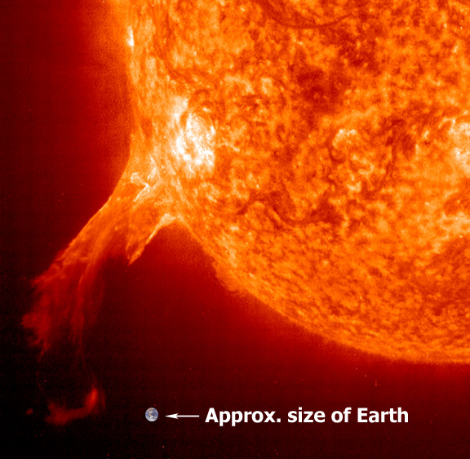
How Big is the Sun?
The sun’s diameter is about 110 times wider than Earth
Photo from http://sohowww.nascom.nasa.gov/bestofsoho/bestofsoho.html
Notes:
Our Sun is 865 thousand miles (1,390,000 km) wide. Even a medium-sized sunspot is as big at the Earth!
Photo from http://sohowww.nascom.nasa.gov/bestofsoho/

Slide 4
How does our Sun compare to other Stars?
Active stars range in size from supergiants to dwarfs
Stars range from very bright (supergiants) to very dim (dwarfs)
Stars range from very hot blue on the outside (O class) to cool red on the outside (M class)
**Our Sun is a dwarf—medium mass
**Our Sun is a medium-bright dwarf
**Our Sun is in-between blue and red. It is a --yellow
Notes:
Supergiants can be hundreds to thousands of times bigger than our Sun, and possibly up to 100 times more massive than our Sun. The smallest stars are about 1/100 of the Sun’s mass.
Temperature ranges for the outside of a star (spectral classification): O (blue), B (blue-white), A (white), F (white-yellow), G (yellow), K (orange), M (red)
Very large stars can be very hot on the outside (O class) or cool on the outside (all the way down to M class)—all large stars are extremely hot in their cores.
All small active stars (excludes remaining cores of old stars) are cooler on the outside and in their cores, compared to the most massive stars.

Slide 5
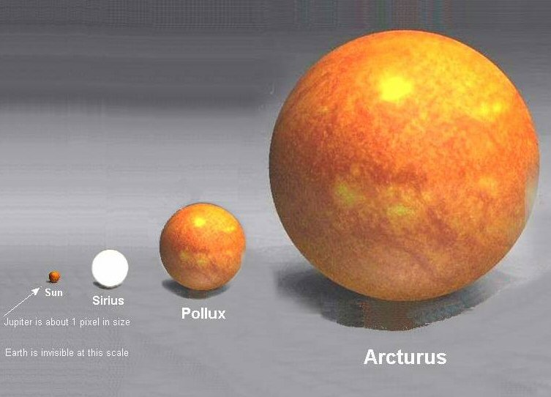
Size vs. distance
Our sun appears to be a large star because it is a lot closer to us than other stars. However there are a lot of other stars that are much larger than the sun.

Slide 6
Rotation
At the equator, the Sun rotates once every 25.4 days
Near its poles, the Sun rotates once every 36 days
Known as “differential rotation”
Notes:
High cadence solar rotation, EIT 195Š(Dec. 10-24, 1999) Movie at http://sohowww.nascom.nasa.gov/bestofsoho/Movies/EITdec99/EITdec99sm.mpg

Slide 7
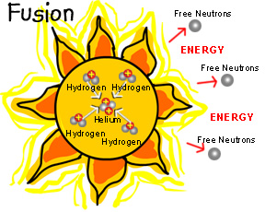
Energy from the Sun
Nuclear fusion, the source of all the energy radiated by the Sun. It does two things: it converts hydrogen into helium (or in other words it makes helium nuclei from protons) and it converts mass to energy (heat & light).
In order for nuclear fusion to occur the following conditions must exist:
-high density
-extreme heat
-large mass
Notes:
Information and images at http://solarscience.msfc.nasa.gov/interior.shtml .

Slide 8
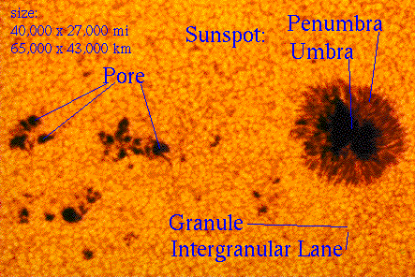
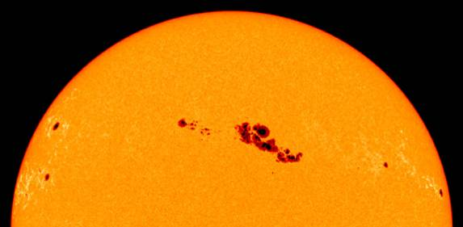
Features in the Photosphere
Sunspots
Dark and small
Cool-- temperatures only 6,200 F (Sun’s surface is 10,000 F)
Occur in 11 year cycles
Notes:
Information at http://solarscience.msfc.nasa.gov/feature1.shtml
Image at http://sohowww.nascom.nasa.gov/gallery/top10/top10_results.html

Slide 9
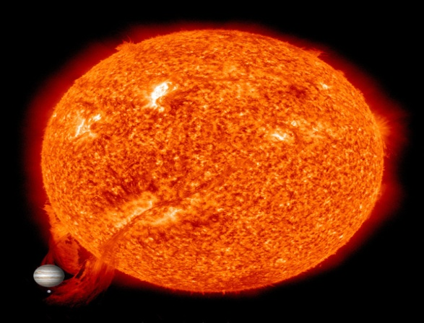
Solar Events
Prominences
-A prominence is a large, bright, gaseous feature extending outward from the Sun's surface, often in a loop shape. Prominences are anchored to the Sun's surface in the photosphere, and extend outwards into the Sun's corona
Notes:
Information on flares at http://solarscience.msfc.nasa.gov/flares.shtml
Movie: Six months with EIT 171 (Aug. 12, 2003 - Feb. 9, 2004) http://sohowww.nascom.nasa.gov/bestofsoho/Movies/171/EIT171sm.mpg

Slide 10
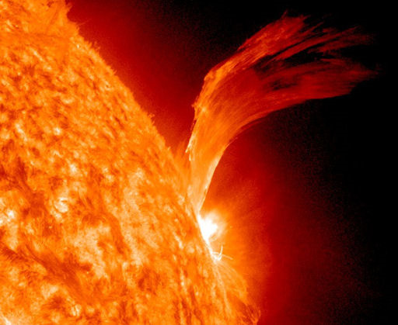
Solar Flares
-Flares-A solar flare is a tremendous explosion on the Sun that happens when energy stored in 'twisted' magnetic fields (usually above sunspots) is suddenly released.
-In a matter of just a few minutes they heat material to many millions of degrees and produce a burst of radiation across the electromagnetic spectrum, including from radio waves to x-rays and gamma rays.

Slide 11
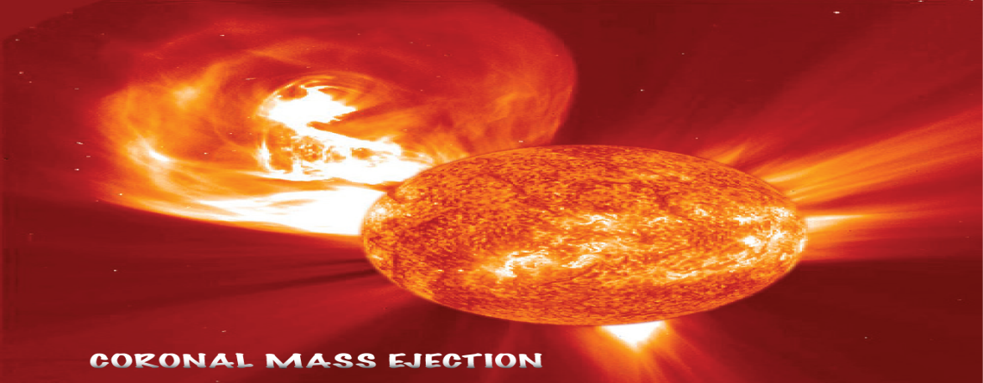
Coronal Mass Ejections
-Coronal Mass Ejections- A coronal mass ejection (CME) is a massive burst of solar wind and magnetic fields rising above the solar corona or being released into space.
CME’s effects on Earth
*Can damage satellites
*Very dangerous to astronauts
*Power problems

Slide 12
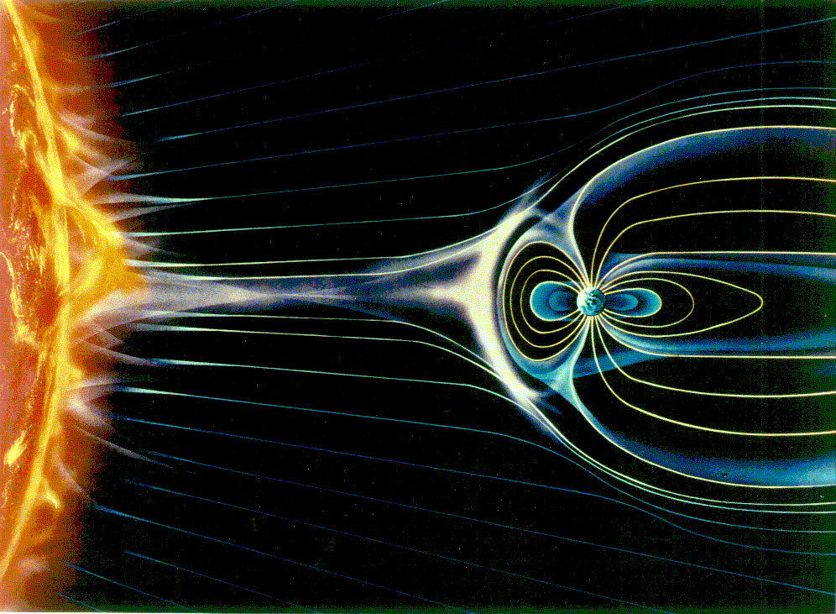
Solar Wind
-Blows charged particles and magnetic fields away from the Sun
-Charged particles captured by Earth’s magnetic field
-Create Auroras or Northern and Southern Lights
Image at http://solarscience.msfc.nasa.gov/the_key.shtml
Notes:
Image and information at http://solarscience.msfc.nasa.gov/the_key.shtml

Slide 13
Auroras
Electrons from solar wind are captured by the Earth’s magnetic field
Interact with atoms in our atmosphere: oxygen and nitrogen make red and green; nitrogen can also make violet
Northern lights are Aurora Borealis, while southern are Aurora Australis
Notes:
Animation of solar wind impacting the magnetosphere and creating aurora http://sohowww.nascom.nasa.gov/bestofsoho/Movies/animation/Solarwind.mpg
A booklet is available at http://ds9.ssl.berkeley.edu/auroras/

Slide 14
Sun’s Radiation at Earth
The Earth’s atmosphere filters out some frequencies
Ozone layer protects us from some ultra-violet, and most x-rays and gamma rays
Water and oxygen absorb some radio waves
Water vapor, carbon dioxide, and ozone absorbs some infrared
Electromagnetic spectrum
http://coolcosmos.ipac.caltech.edu/cosmic_classroom/ir_tutorial/what_is_ir.html
.
Notes:
http://coolcosmos.ipac.caltech.edu/cosmic_classroom/ir_tutorial/what_is_ir.html

Slide 15
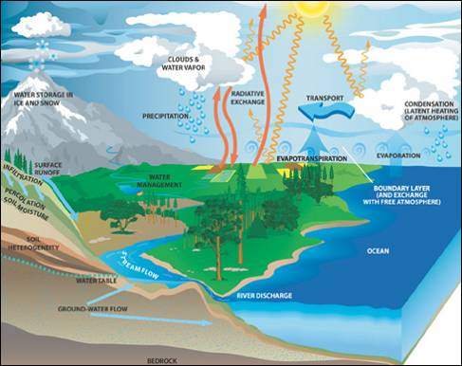
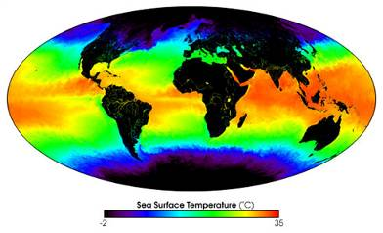
Sun as a Source of Energy
Light from the Sun is absorbed by the Earth, unevenly to:
drive wind bands – which drive surface currents
drive deep ocean currents
drive water cycle
drive weather
Notes:
Left image caption Every day the Moderate-resolution Imaging Spectroradiometer (MODIS) measures sea surface temperature over the entire globe with high accuracy. This false-color image shows a one-month composite for May 2001. Red and yellow indicates warmer temperatures, green is an intermediate value, while blues and then purples are progressively colder values.
Information about the water cycle at http://science.hq.nasa.gov/oceans/system/water.html

