Slide 1
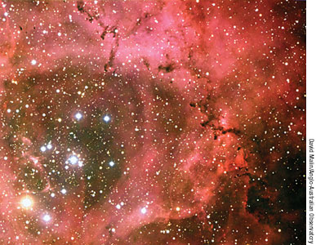
Life Cycle of Stars
1st Step:
Stars form from nebulas
Regions of concentrated dust and gas
Gas and dust begin to collide, contract and heat up
All due to gravity

Slide 2
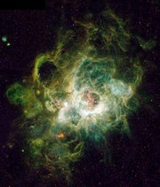
Life Cycle of Stars
2nd Step:
As nebula contracts, a small star is formed
Called a protostar
Eventually, the protostar will begin nuclear fusion
Hydrogen protons attract to each other
Strong nuclear force
Fusion begins
Necessary for stars to survive

Slide 3
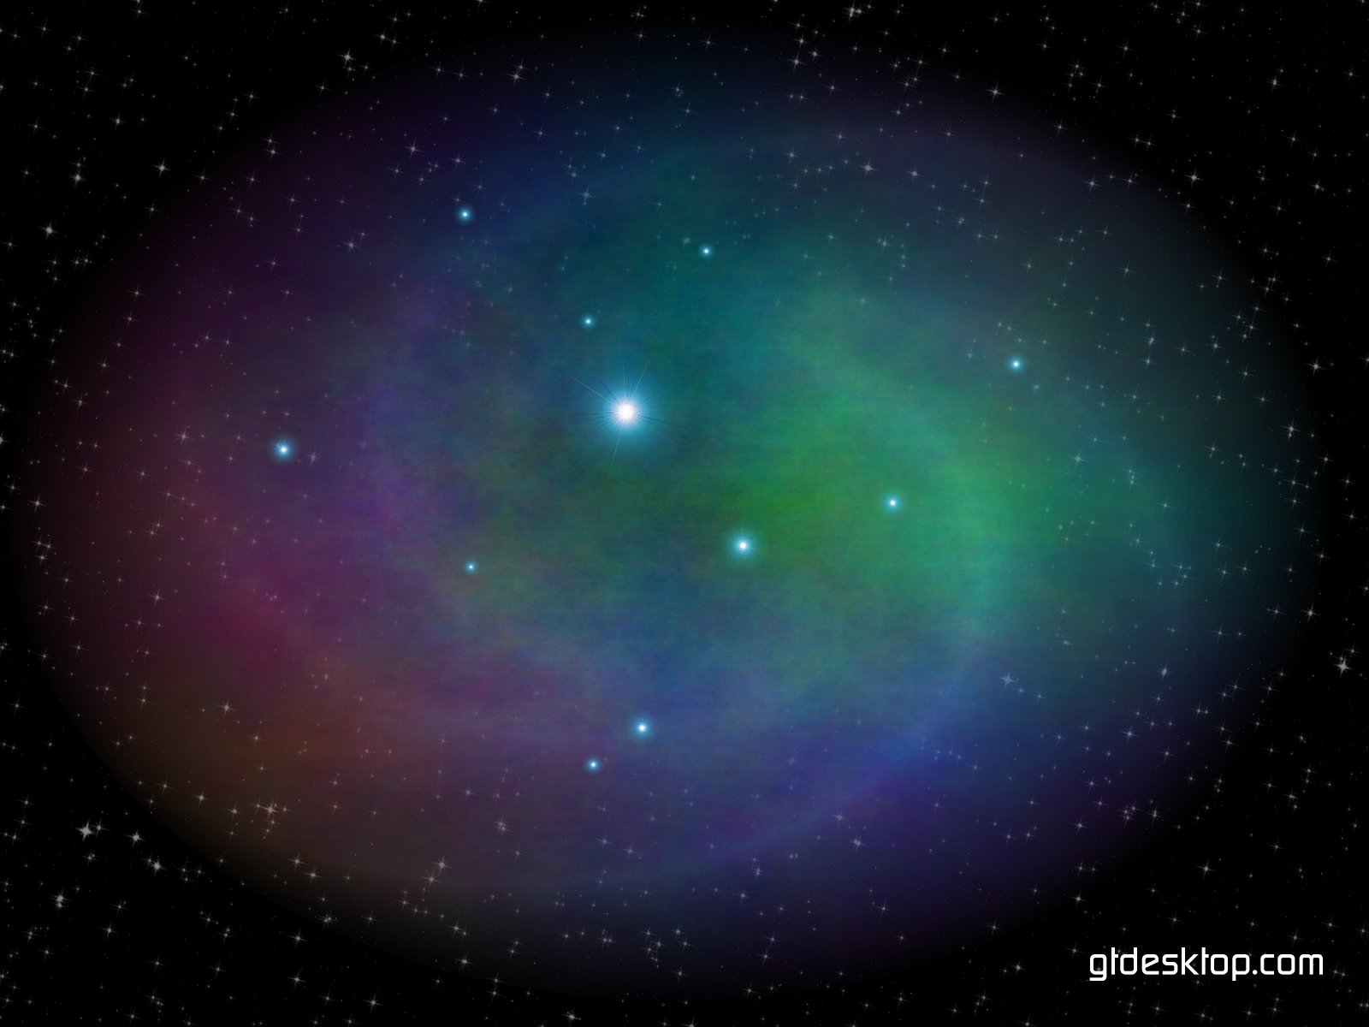
Life Cycle of Stars
3rd Step:
Star joins the main sequence
90% of stars spend life here
Nuclear fusion = Hydrogen into Helium
Mass of star determines location on main sequence

Slide 4
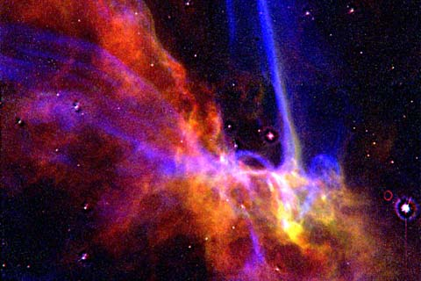
Life Cycle of Stars
Beginning of the End:
Stars begin to die when they run out of hydrogen
Gravity begins to take over
Star begins to shrink; outer core of hydrogen begins to fuse
Star gets bigger

Slide 5
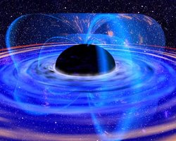
Life Cycle of Stars
Beginning of the End:
When star gets bigger, it cools down
Red giant
Eventually, star can fuse helium into other elements
Carbon, oxygen, and other heavier elements

Slide 6
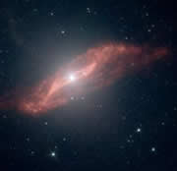
Life Cycle of Stars
Beginning of the End:
Once star runs out of “fuel”, star shrinks under its own gravity
Turn into a white dwarf, neutron star, or black hole

Slide 7
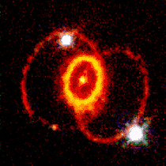
Life Cycle of Stars
Death of Stars:
What stars end up as depend on mass
Low and Medium mass stars
Planetary nebula --------- white dwarf
High mass stars
Supernova --------- neutron star or black hole

Slide 8
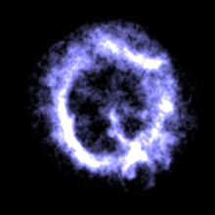
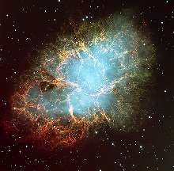
Life Cycle of Stars
Death of Stars: Low and Medium Mass
Main Sequence Star
Red Giant
Planetary Nebula
White Dwarf

Slide 9
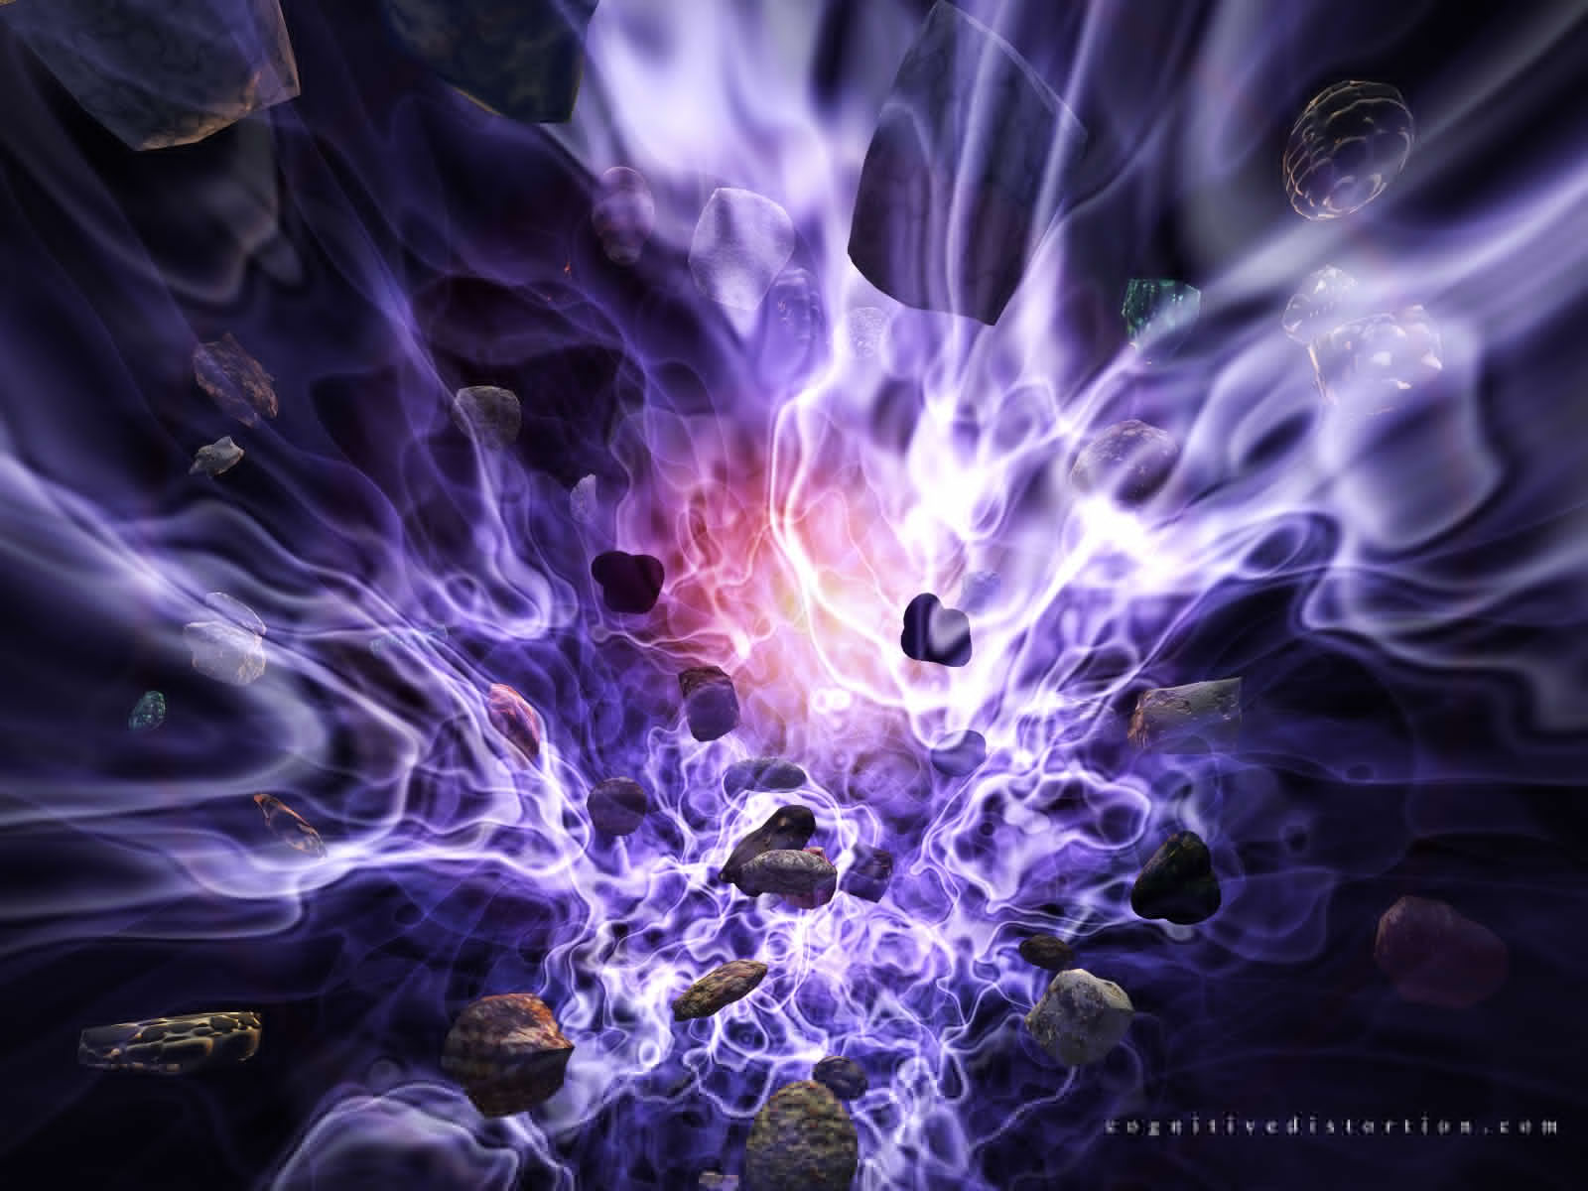
Life Cycle of Stars
Death of Stars: High Mass
Main Sequence Star
Red Super Giant
Supernova
Neutron Star
Black Hole

Slide 10
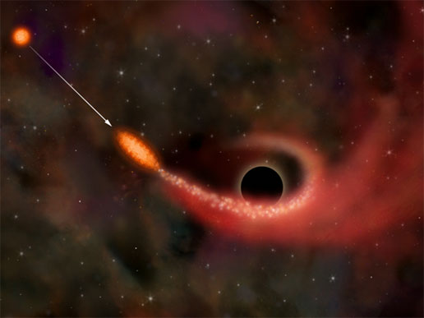
Black Holes
Black Holes Info Sheet
What is a Black Hole???
An object so massive and dense that not even light can escape its gravity
The end result from a supernova of a star that has a mass greater than 3x the sun

Slide 11
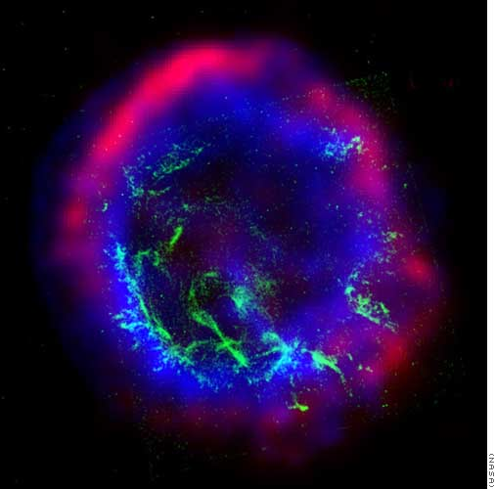
Life Cycle of Stars
High Mass Stars:
Mass greater than 8x our sun
Create high mass elements such as iron
Neutron Star
Formed if remaining star < 3x sun’s mass
Black Holes
Formed if remaining star > 3x sun’s mass

Slide 12
Life Cycle of the Sun
As fusion begins to slow down, the core of the sun will contract
Temperature in the core will rise
The outer layers of the sun will expand, consuming in the inner planets
Sun will become a Red Giant

Slide 13
Life Cycle of the Sun

Slide 14
Life Cycle of the Sun
Core of the sun will begin to fuse helium into larger elements such as carbon and oxygen
Continuing over the next 100 million years…
Core will become entirely carbon and oxygen
Core will contract
Outer layers will expand
Outer layers will form a planetary nebula
Core of sun will become a white dwarf

